Slide 1
Lecture 3 – Product Life Cycle and the Systems Engineering Process
Notes:
Appreciating that a product or system exists outside of the design and test phase is sometimes a hard concept for an engineer to grasp. This results in products that may be terrific in capability built are expensive to own or operate or may be unsupportable in the long run. Disposal of wastes and hazardous byproducts is a problem in all industries and a function of not considering the total life cycle of a product, including its disposal. In this lecture we’ll try to raise awareness of the total life cycle.

Slide 2
Overview
Department of Defense (DOD) Project Life Cycle Definitions
  Technology Readiness Levels
NASA Project Phase Definitions
System Engineering Concerns during different phases of the life cycle
  Case study – re-establishing systems engineering in the shuttle program following Columbia
The Systems Engineering Process – SIMILAR
Notes:
DOD is a $300B a year enterprise so it tends to drive a lot of our economy. Systems Engineering processes of the DOD are important to study because so many companies which do both commercial and DOD business use DOD processes in all of their business because it is too hard to have two different types of processes.
NASA is a good example because it is heavy Research and Development (R&D) up-front like many commercial companies with heavy R&D (e.g. Google or Apple) however its processes are in the public domain so we can discuss them.
SIMILAR is a model for Systems Engineering that is supported by INCOSE

Slide 3
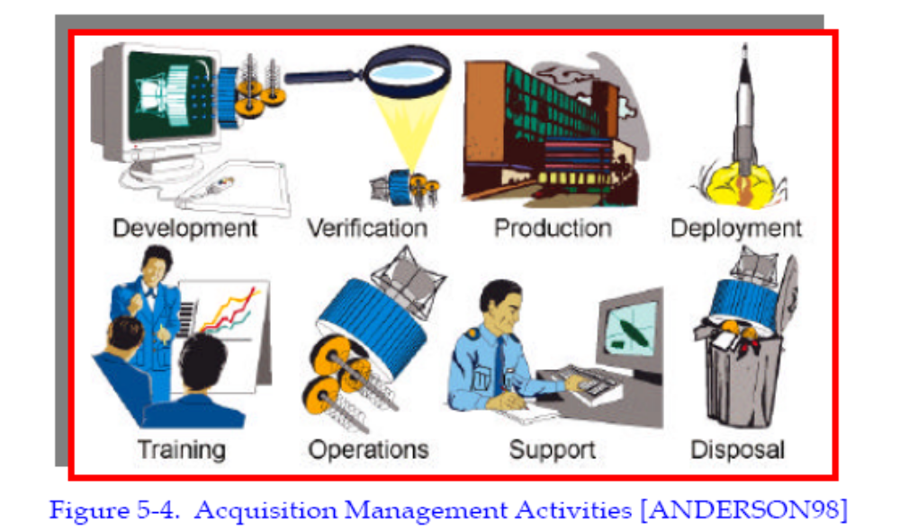
Department of Defense (DOD) Example – Communications Satellite Life Cycle
www.stsc.hill.af.mil/resources/tech_docs/gsam3/chap5.pdf
Notes:
When an organization has a series of long projects such as DOD or NASA, an engineer may have twenty years experience but only experienced one or two phases of a project’s life cycle. This is also true of engineers who only specialize in one phase such as design or test or support. It is hard to consider the other phases if you have no experience of them.
In this lecture we are going to talk about the phases and the systems engineering role in each phase.

Slide 4
Stages of Life Cycle
Development – Design Engineering and Prototyping, Initial Manufacture
Verification – Determining if design meets requirements
Production – repeated unit manufacture
Deployment – placing the product in its operational environment and initial operational testing
Training – teaching people how to operate and maintain the system
Operations – using the product
Support – dealing with failures, users desires for improvements, parts obsolescence, finding new suppliers and qualifying replacement parts and materials
Disposal – dealing with values of components at the end of a project
Phases can overlap – Development, Verification and Production can overlap.
Training, Operations and Support usually overlap

Slide 5
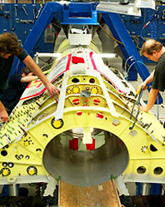
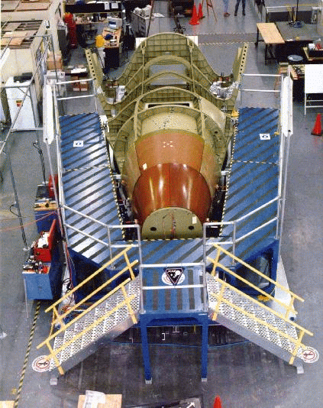
Concerns during different phases of the life cycle – development, verification and production
Development – technical challenges, design engineering, technology readiness, budget, schedule, political support
Verification – test requirements, ability to re-create combined environments, test facilities and procedures, availability of hardware, dispositioning test discrepancies, cost and schedule
Production – manufacturing jigs and tooling to hold articles as they are manufactured, ability to produce parts, ability to precisely align and assemble parts, quality assurance and inspection of parts versus drawings, suppliers availability, economies of scale, cost and schedule
Assembly jig
Saab JAS-39 Grippen
X-38 Assembly
Jig
Notes:
Pictures of assembly jigs for the JAS-39 Grippen fighter and the X-38. Assembly jigs hold the parts in place while a vehicle is being assembled.

Slide 6
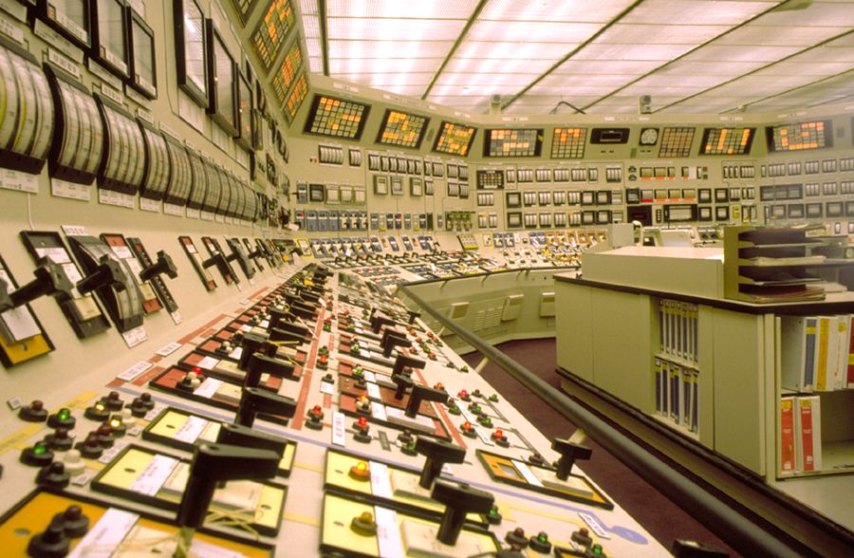
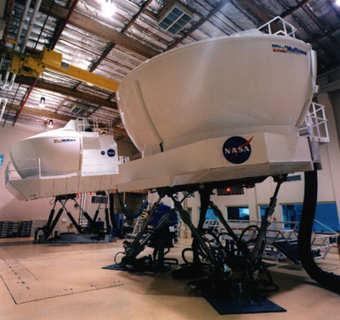
Concerns during different phases of the life cycle – deployment, training, operations
Deployment – delivery mechanisms, initial training and support, initial testing in the operational environment, late development stage bugs, initial operational problems, mishap investigation, cost and schedule
Training – system detail necessary to generate training materials and simulators/mockups, availability of training for instructors, availability of hardware and software to support training, cost and schedule
Operations – Proper operational procedures, engineering support to generate operational procedures, software, tools, procedures and tools to deal with malfunctions, dealing with anomalies, cost and schedule
Full motion simulator
Nuclear Power Plant Control Room

Slide 7
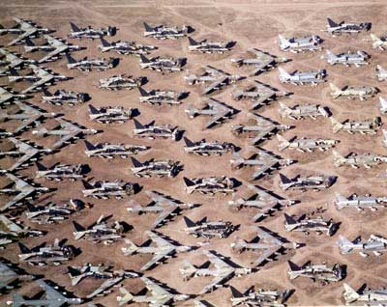
Concerns during different phases of the life cycle – support and disposal
Support –dealing with failures, incorporating users desires for improvements, parts obsolescence, finding new suppliers and qualifying replacement parts and materials
Disposal – dealing with all of the values and issues associated with the end of life of a program
  Historical value
  Monetary value– scrap or salvage
  Security Classification/Protection of other privileged information (copyright, medical, export control, industrial secrets)
  Re-use by other programs
  Environmental remediation
  International agreements
  Documentation of results/information for future programs
  Closing out contracts
B-52 Boneyard at Davis-Monathan AFB
Photo from wikipedia

Slide 8
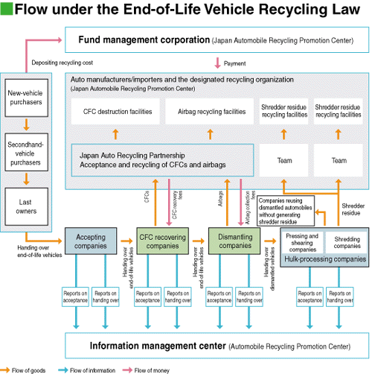
Automobile Parts Recycling and Environmental Remediation - Toyota

Slide 9
Stages of Life Cycle Versus Normal Engineering Education
Development
Verification
Production
Deployment
Training
Operations
Support
Disposal
Subjects normally covered in engineering education
Subjects not normally covered in engineering education
Fads in the industry such as “design for operability”, design for maintainability” and
“design for production” which occur every few years just reflect the fact that we
are only teaching about part of the life cycle

Slide 10
Research Engineering Versus Engineering Designers
In his 2002 book “The Secret of Apollo, Systems Management in American and European Space Programs”, Stephen Johnson points out
  “Engineers can be divided into two types: researchers and designers.
  Engineering researchers are similar to scientists, except that their quest involves technological novelty instead of “natural” novelty. They work in academia, government and industrial laboratories and have norms involving the publication of papers, the development of new technologies and processes and the diffusion of knowledge.
  By contrast, engineering designers spend most of their time designing, building and testing artifacts. Depending upon the product, the success criteria involve cost, reliability and performance. Design engineers have little time for publication and claim expertise through product success”
This dichotomy explains why engineering education traditionally focuses on a relatively small part of the product life cycle
Typically university professors are research engineers versus engineering designers and do not often deal with the other parts of the life cycle

Slide 11
Because engineering educators tend to be interested in innovation
Our education tends to be focused on items that are on the cutting edge of technology
When doing real projects, it is vitally important to make sure that the technologies selected for a project are appropriate
Choosing technologies that are not mature enough for a project can cause disaster
Rating technology readiness on a scale can help you evaluate and select appropriate technologies
NASA and DOD have Technology Readiness Levels (TRL’s) that are good example of how to do this that can be tuned/adapted for a specific industry

Slide 12
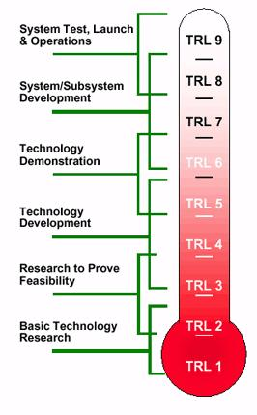
Technology Readiness Level
9. Actual system 'flight proven' through successful mission operations
8. Actual system completed and 'flight qualified' through test and demonstration (ground or space)
7. System prototype demonstration in a space environment
6. System/subsystem model or prototype demonstration in a relevant environment (ground or space)
5. Component and/or breadboard validation in relevant environment
4. Component and/or breadboard validation in laboratory environment
3. Analytical and experimental critical function and/or characteristic proof of concept
2. Technology concept and/or application formulated
1. Basic principles observed and reported
NASA Technology Readiness Levels
Notes:
TRLs are how NASA determines if technologies are ready to use in projects.
In a basic research project you would work with technologies at TRL 1-2.
In a technology development project you would be working with TRL 3-4.
In a technology demonstration project you would work at levels 5-7.
In an operational vehicle such as a launch vehicle, science satellite or human carrying vehicle, you would want to select technologies at 8-9 and only go lower than that if performance requirements demanded it. Even then you would want to budget a lot of resource to “level up” that technology before you proceeded very far in a program.
The problem is that you may have appropriate mature technologies in most of your work but it sis the one that is less mature than you need it to be that causes you all the trouble.
By explicitly describing all of the required technologies for a project using a rating scale like this, you can make the technology challenges visible.

Slide 13
DOD Technology Readiness Levels
Technology Readiness Level | Description
1. Basic principles observed and reported | Lowest level of technology readiness. Scientific research begins to be translated into applied research and development. Example might include paper studies of a technology's basic properties.
2. Technology concept and/or application formulated | Invention begins. Once basic principles are observed, practical applications can be invented. The application is speculative and there is no proof or detailed analysis to support the assumption. Examples are still limited to paper studies.
3. Analytical and experimental critical function and/or characteristic proof of concept | Active research and development is initiated. This includes analytical studies and laboratory studies to physically validate analytical predictions of separate elements of the technology. Examples include components that are not yet integrated or representative.
4. Component and/or breadboard validation in laboratory environment | Basic technological components are integrated to establish that the pieces will work together. This is relatively "low fidelity" compared to the eventual system. Examples include integration of 'ad hoc' hardware in a laboratory.
5. Component and/or breadboard validation in relevant environment | Fidelity of breadboard technology increases significantly. The basic technological components are integrated with reasonably realistic supporting elements so that the technology can be tested in a simulated environment. Examples include 'high fidelity' laboratory integration of components.
6. System/subsystem model or prototype demonstration in a relevant environment | Representative model or prototype system, which is well beyond the breadboard tested for TRL 5, is tested in a relevant environment. Represents a major step up in a technology's demonstrated readiness. Examples include testing a prototype in a high fidelity laboratory environment or in simulated operational environment.
7. System prototype demonstration in an operational environment | Prototype near or at planned operational system. Represents a major step up from TRL 6, requiring the demonstration of an actual system prototype in an operational environment, such as in an aircraft, vehicle or space. Examples include testing the prototype in a test bed aircraft.
8. Actual system completed and 'flight qualified' through test and demonstration | Technology has been proven to work in its final form and under expected conditions. In almost all cases, this TRL represents the end of true system development. Examples include developmental test and evaluation of the system in its intended weapon system to determine if it meets design specifications.
9. Actual system 'flight proven' through successful mission operations | Actual application of the technology in its final form and under mission conditions, such as those encountered in operational test and evaluation. In almost all cases, this is the end of the last "bug fixing" aspects of true system development. Examples include using the system under operational mission conditions.
Technology Readiness Levels in the Department of Defense (DOD)
(Source: DOD (2006), Defense Acquisition Guidebook)
Notes:
The DOD TRLs are similar to the NASA but not as tightly tied to flying projects as an ultimate goal.

Slide 14
What happens when a key technology to make a project work is not mature enough ?
Implications
  Cost increase
  schedule delay
  potential cancellation
  Operational failure
What do you do if you have a technology that isn’t mature enough?
  Describe it as a program technical risk
  Often do a technology development program to develop that technology before fully commit to a program
  Example – shuttle main engine development was started in advance of shuttle program because reusable engine development was considered high risk
NASA program life cycle definition includes phases for high risk technology development reflecting NASA’s R&D nature
  This is called technical risk reduction

Slide 15
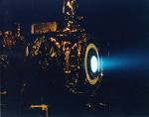
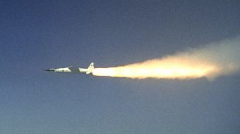
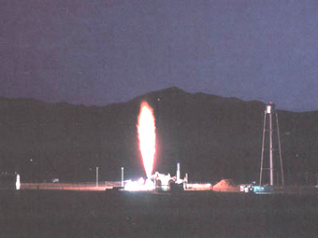
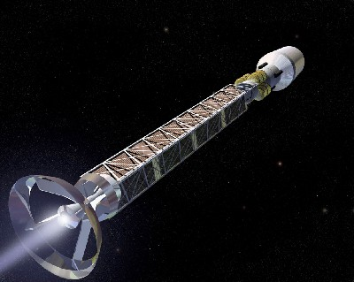
Examples :
Identify the TRLs of the following propulsion technologies
  Aluminum powder based solid rockets – 9 – used routinely in shuttle
  Liquid oxygen/hydrogen liquid rockets – 9 – used routinely in shuttle
  Ion engines - 8 in small scale - tested on satellites on Deep Space One and Dawn mission
  Scramjet – 7 - Tested Inflight – X-43 Hyer-X
  Nuclear rocket engines – 4-5 - tested on the ground – NERVA
  Laser engines – 4 – tested on the ground
  Antimatter engines – 3-4 – basic principles understood
  Antigravity – 0 – no idea on how to make that work yet
Deep Space One Ion Thruster
HyperX
NERVA test
Conceptual AntiMatter Engine Spacecraft

Slide 16
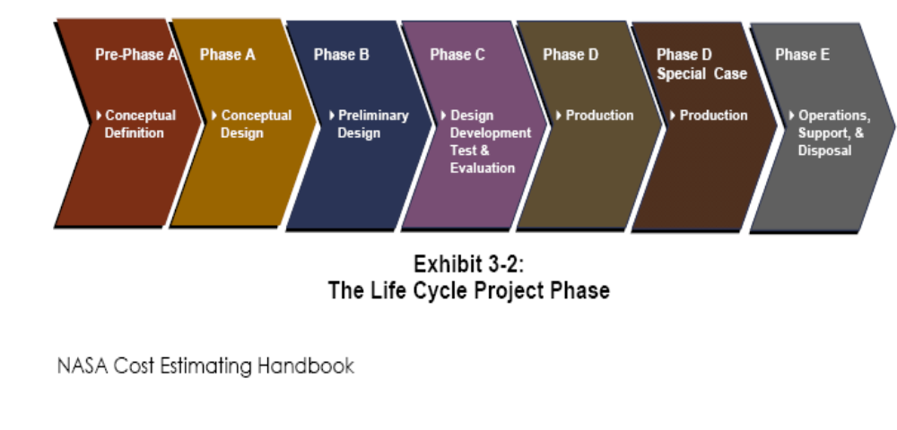
NASA Life Cycle Phases
This definition reflects NASA’s orientation towards R&D projects with greater emphasis on early design and project formulation and proposal
  Many NASA projects never make it past pre-phase A or phase A
  Many projects have extended phase A while building support for funding the entire project and reducing risk in key technologies
Note that this definition does not normally have overlapping phases

Slide 17
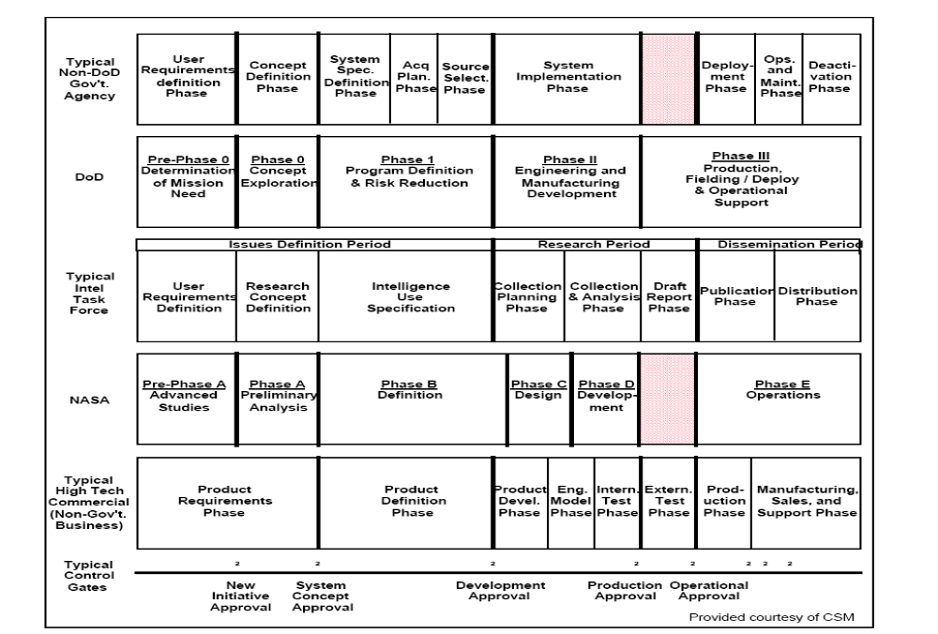
Comparison From INCOSE Sys Engineering Handbook
Notes:
This chart is very revealing in that it shows that even though different terminology is sued in different industries or government applications, that the same basic concepts are addressed.
This shows that the basic phases in a life cycle are basically the same, independent of industry. The differences in the terminology reflects the fact that the procedures in the different industries all developed independently as the industries/agencies grappled with systems of increasing complexity. Systems Engineering as a discipline suffers from the fact that different organizations developed their own ways of developing and managing complex systems before the basic principles and terminology of systems engineering were established.
Control Gates refer to milestones where future effort is approved and that progress must be demonstrated before you pass through a control gate into the next phase.
As you can see in each of these examples there is a development phase, consisting of developing requirements and performing design, there is a production phase, a deployment and operational phase. Note that even this chart from the INCOSE Systems Engineering Notebook does not address training, support and disposal.

Slide 18
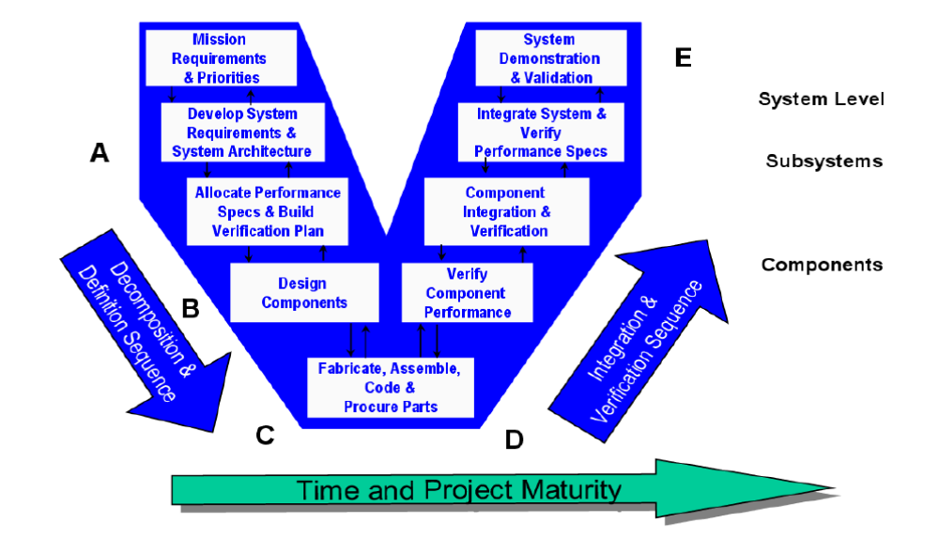
Relationship To Integration Activities
Notes:
All of these pieces tie together. Remember in the last lecture we talked about the Systems integration VEE ? Well we can map the development and verification phases to the VEE.
Development
Verification

Slide 19
Systems Engineering Concerns during different phases of the life cycle
Development –
  have we forgotten to build anything ?
  Will it all work together ?
  Are the interfaces correct, documented and is everyone working to the same interfaces ?
  What is our prediction of integrated performance ? What are our assumptions ? Are they still valid ?
  Are we keeping within our assigned technical budgets (weight, power, etc…)
Verification –
  have we forgotten to test anything ? Have we tested all requirements ?
  Does it all work together ?
  Are we meeting interface agreements ?
  If we can’t test in the combined environment (thermal, aeroloads, inertial loads, shock and vibration) can we test separately and combine analytically ?
Production
  Do the production builds reflect the design ? – are we building what we designed and tested ?

Slide 20
Systems Engineering Concerns during different phases of the life cycle
Deployment
  How do we get thru unique stages (such as launch)
  Determining readiness for first deployment
  Initial testing in operational environment (flight test)
  Dealing with first time anomalies
Training
  What types of training devices are needed ?
  How do we keep the people building training devices in sync with the people doing the design
    Simulators and other training devices take time to develop but they are needed just as development is over or perhaps before
Operations
  Do we understand the effect of changes or anomalies in one part of the system on the other parts of the system
Support
  Do we have the necessary facilities to replicate anomalies, analyze data and generate changes/fixes ?
  Have we though thru all of the implications of fixes ?
Disposal
  Have we though thru all of the pieces and their constraints on disposal

Slide 21
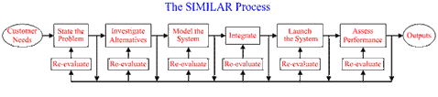
Systems Engineering Process – Runs in parallel with each phase of the program life cycle
State the Problem
Investigate Alternatives
Model the System
Integrate
Launch the system
Assess Performance
Re-evaluate
From:INCOSE – International Committee on Systems Engineering
Notes:
The SIMILAR model incorporates many of the lessons learned from implementing large systems. When you break it down, it really is quite simple.
First – you always start with a need from a customer – whether internal or external. After all, if there is no need, why are you building a system ?
Second, State the problem – often we launch off into the problem and get part way thru before we realize what the real problem that we are trying to solve is. If we can’t state the problem, how can we ever hope to solve it.
Third – Investigate alternatives. There is always more than one way to “skin a cat”. Look for alternatives.
Fourth – model the system – with a physical model, with a mathematical model, with an analytical model or with a simulation model. The purpose of modeling is to evaluate the alternatives to pick the best one and also to predict the performance of the solution. It also rapidly tells you how well you really understand the problem and where the gaps in your knowledge are.
Then you launch the system – build it and run it, assess the performance (comparing it to the results of your prediction model) and then re-evaluate what you are doing to improve or change as necessary

Slide 22
SIMILAR process
A revision of the SIMILAR process is done in each phase of the life cycle
  Slightly different problem statements
  The system launch may just be to the next phase rather than actual deployment
  Fidelity of modeling improves with each phase
  Modeling is the only way to understand the implications of the selected solutions in advance of final deployment
    Modeling may be the only way to generate the combined environment of actual operations
      It may not be possible to replicate the combined effect of dynamic pressure, internal pressure, thermal, vibration, static pressure, shock and electromagnetic loads in a single ground test
      May have to do separate tests and combine the results

Slide 23
Any questions ?

